Slide 1

THE ANATOMY
OF A
SOCIAL CEO
Ananya Garg | Aishwarya Pawar | Sahana Subramanian
Puja Subramaniam | Sayesha Aravapalli
Notes:
Puja

Slide 2
AGENDA
01
02
PROBLEM AND
SIGNIFICANCE
DATA SOURCE AND
PRE-PROCESSING
03
04
ANALYSIS
INSIGHTS AND
NEXT STEPS

Slide 3

BUSINESS
PROBLEM
How should a CEO be active on Twitter to increase business success?
Notes:
Our client is a large company who is trying to determine whether to get their CEO on Twitter. They want to ensure that this is a worthwhile investment or not. We have offered to look into what other CEOs tweet about, to give our CEO a basic understanding of what she would need to do. We also look into customer engagement based on these tweets, and what topics help the company build their brand presence. We tie it all together by looking at whether these tweets offer any support for increased success in the company’s value.

Slide 4
Problem Significance
RELEVANCE
ENGAGEMENT
BUSINESS SUCCESS
81% of survey respondents feel that CEOs who engage in social media are better equipped to lead their respective company
Allows CEOs to build their company brand, encourage company culture, and set the tone for how customers should view the business
Monthly active users on Twitter has increased, so direct interaction with the CEO/brand increases company presence.
http://www.brandfog.com/CEOSocialMediaSurvey/BRANDfog_2012_CEO_Survey.pdf
Notes:
http://www.brandfog.com/CEOSocialMediaSurvey/BRANDfog_2012_CEO_Survey.pdf

Slide 5
Overview of Data
INDUSTRY
31
Finance
Services
TOTAL NUMBER OF CEO TWITTER ACCOUNTS ANALYZED
Tech
Airline
87.5%
12.5%
Auto
GENDER
Non-profit
Media
Food
Notes:
Sayesha
Airline - 3
Auto -3
Finance - 3
Food -1 media
Services - 2
Tech - 17

Slide 6
Methodology
Insights
Step 4
Step 4
Scrape daily stock data and financial statistics for the companies of these CEOs from Yahoo Finance
Analysis:
Sentiment Analysis
Topic Analysis
Market Analysis
Engagement Analysis
Step 3
Step 1
Scrape Twitter using API to collect tweets from 31 CEOs
Step 2

Slide 7
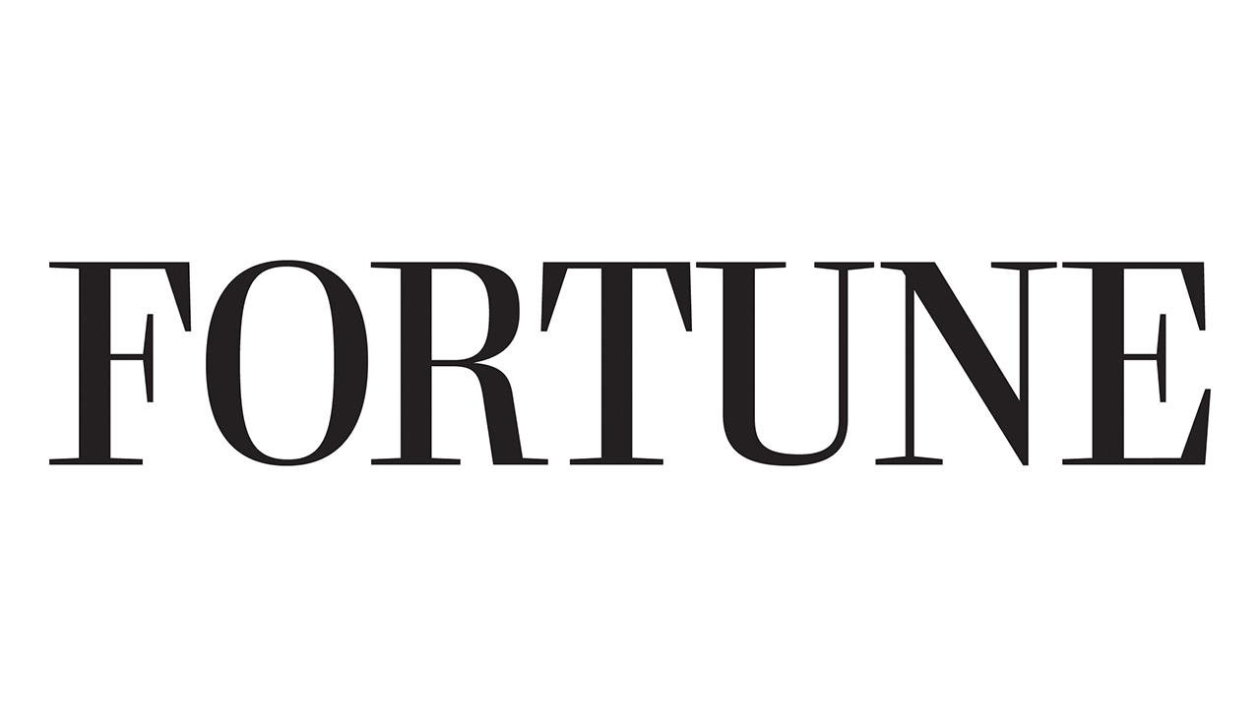


Data Pre-processing
Get CEOs of Fortune 100 companies
Get tweets of these CEOs from 2016
Get data on daily returns and statistical information of the companies
Stop-words removal, bigrams, lemmatize, word-frequency filters
Engagement scores, sentiment analysis and LDA
Regression with the market data
VIF and results!

Slide 8
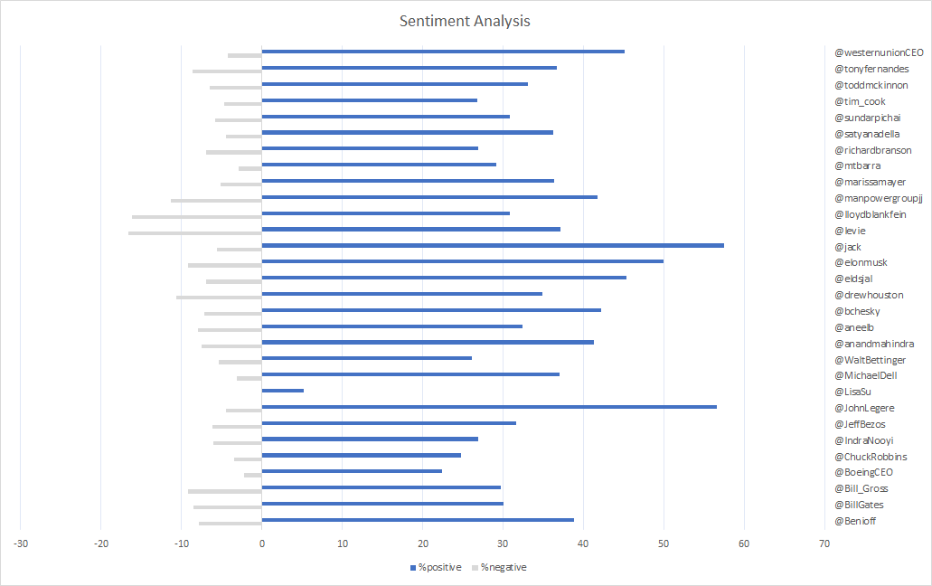
Sentiment Analysis
Most negative:
Box (@levie)
Goldman Sachs (@lloydblankfein)
Most positive:
Twitter (@jack)
T-mobile (@JohnLegere)

Slide 9
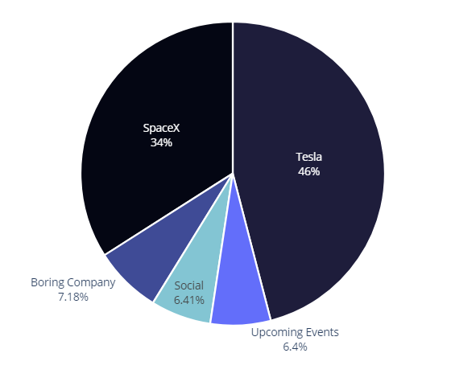
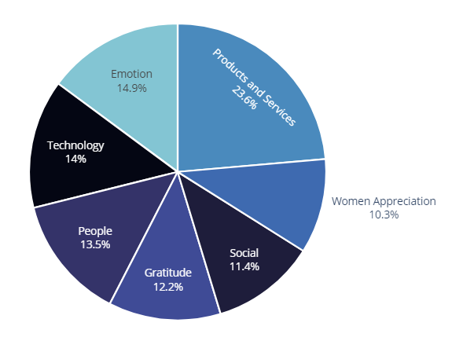
Tweeting Styles
ELON MUSK
TIM COOK
Notes:
Once we did sentiment analysis, we wanted to dig deeper into what kind of topics each of the CEOs are talking about which led us to perform LDA on each of them.
What you see on the slide is an example of the the tweeting styles of two prominent CEOS that are very different.
For example, Elon Musk has a very casual tweeting style which as you know has gotten him into trouble. From the graph, it is clear that He uses Twitter mainly as a marketing tool where he talks about his various products.
On the other hand, Tim Cook makes a lot of statements about current events and clarifies what Apple is doing to help out. We also saw that he tries to
connects with his followers by retweeting their pictures and captions it with the very popular hashtag #shotoniphone

Slide 10
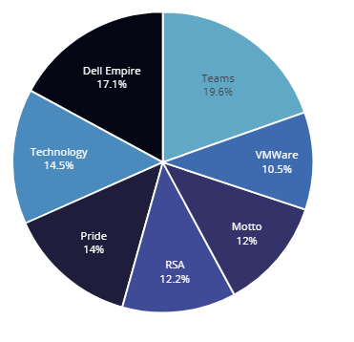
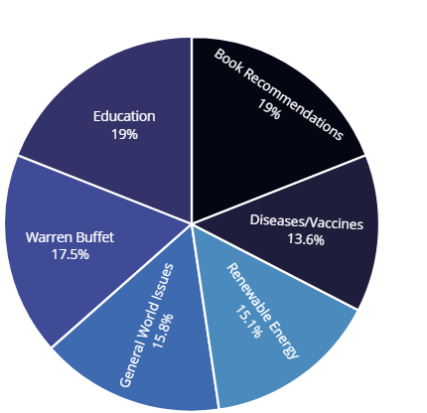
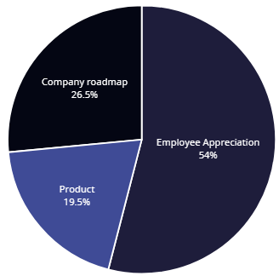
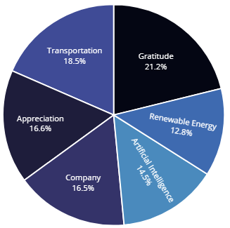
CEOs - Same yet different!
Michael Dell, Dell
Bill Gates, Microsoft/B&MGF
Company products
Team/Colleagues
Company roadmaps
Motivations/Mottos
Upcoming developments in organization sector
Personal interests
Gratitude & empathy
Social causes
Explorative technologies
Dennis Muilenburg, Boeing
Bill Gross, IdeaLab
Notes:
As we proceeded with our analysis, a contrast that we were able to discern was that some of the CEOs were very company focused and their tweets mainly discussed their products and services, their employees and their company vision.
There were some other CEOs who used Twitter as a platform to talk about their personal interests and their take on social and global issues. For example, if you see 19% of Bill Gates' tweets are book recommendations. These CEos are using social media to establish an emotional connection with their followers and who by association can also connect to their brand.

Slide 11
Company Map
Tech
Elon Musk (Tesla)
Michael Dell (Dell)
Aaron Levie (Box)
Sundar Pichai (Google)
Daniel Ek (Spotify)
Satya Nadella (Microsoft)
Tim Cook (Apple)
John Legere (T-Mobile)
Bill Gross (Idealab)
Drew Houston (Dropbox)
Marc Benioff (Salesforce)
Jack Dorsey (Twitter)
Company Related
Non-Company Related
Dennis Muilenburg (Boeing)
David M. Solomon (Goldman Sachs)
Robert Thomson (Newscorp)
Brian Chesky (AirBNB)
Richard Branson (Virgin)
Bill Gates
(Microsoft/Bill & Melinda Gates Foundation)
Anand Mahindra (Mahinda Group)
Indira Nooyi (Pepsico)
Marissa Mayer (Yahoo)
Non-Tech
Notes:
We did this excercise for each of the CEOs and we were able to broadly classify them into 4 buckets based on the kind of company that they were a part of (tech/non tech) and the kind of tweets (company related or general topics).

Slide 12
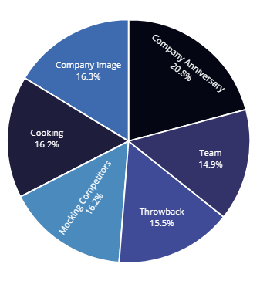
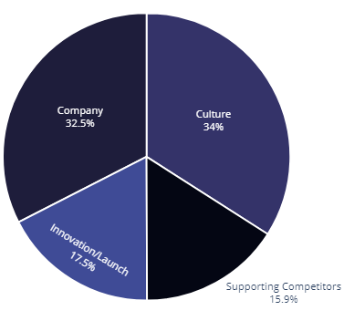
Sentiment Analysis vs. Topic Modeling
JOHN LEGERE
AARON LEVIE
Notes:
From the sentiment analysis, we found that john legere had the most positive tweets , whereas aron levie had the most -ve tweets. However, when we looked into the topics, we found out that john legere is mocking the competitors and being sarcastic in many of his tweets. On the other hand aron levie is praising the competitor initiatives and talking about the company. So, we decided to include both the things for out market analysis.

Slide 13
Market Analysis
CEO Attributes
Tweet Attributes
Company Attributes
Age
Compensation
Gender
Charisma:
Glassdoor approval score
# of Twitter followers
Tweeting style / topics
Personal
Business/Product
Social
Emotion
Technology
Sentiment scores
Retweets & Likes
Company statistics
Current Ratio
Cashflow
Cash per share
Outstanding shares
Market cap
Company leverage
Daily Returns
Volume of stock traded
Notes:
Check from picture

Slide 14
Factors Affecting Stock Prices
Twitter Followers
Sentiment Score
Technology
Emotion
Business
Notes:
Measured in share volume
Financial model to stabilize the model

Slide 15
Customer Engagement
CEO’s views on social issues + company technology
Social
Technology
Engagement score measured by:
60% 40%
Emotion
Product
GlassDoor CEO Approval
Personal

Slide 16
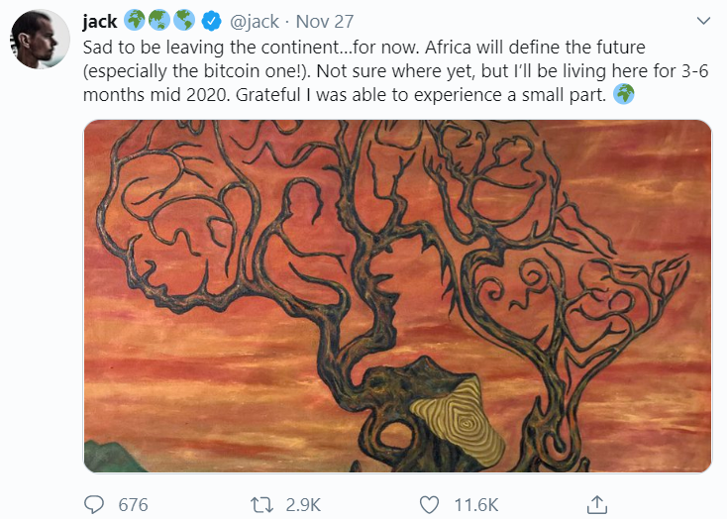
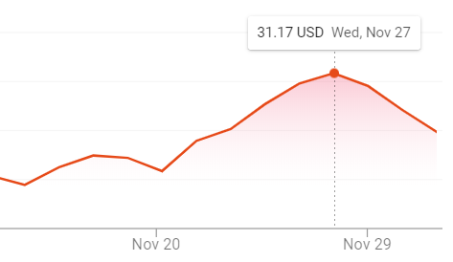
Engagement Score IRL
Jack Dorsey’s personal trip affects us
Effect on Twitter’s stock price
Notes:
Our main concern was if the stocks are influenced by actual events or just the tweets. Here are two examples for it.
Jack Dorsey’s personal trip to Africa would’ve never reached masses otherwise, and wouldn't affect stock. But we saw a steady rise being broken by this

Slide 17
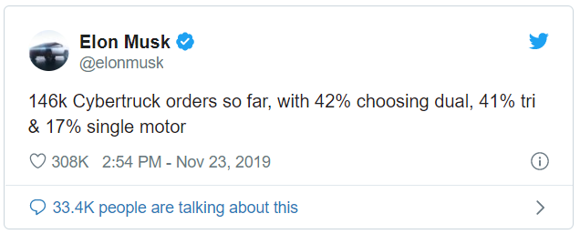
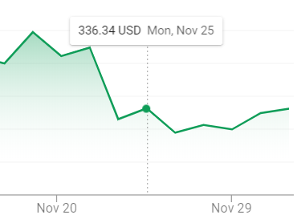
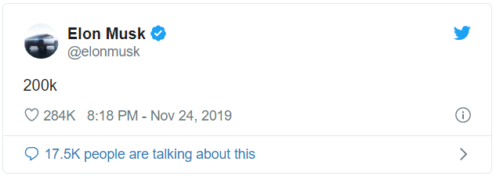
Engagement Score IRL
Elon Musk’s tweets on the product and tech
Effect on Tesla’s stock price
Notes:
After a botched presentation of bullet proof glass, elon musk was able to salvage his stock price over the weekend by tweeting the orderds flowing

Slide 18
Our Advice
Why?
What?
How?
Relate with emotion
Gain investor trust
Connect with employees & customers
Higher engagement with customers & followers
Turning the negative into the positive
Post about company → new launches, products, etc.
Talk about current events
Notes:
Why should they be on twitter:
Increase engagement - we saw engagement has a high effect on stock price
Connect with people they would not meet otherwise
What should they talk about
Analysis yields that people engage with personal information
Get people excited about new technology
Get an idea about the sentiment and address concerns
How is this going to help
Positive sentiments can be created from negative

Slide 19
Potential Concerns
SENSITIVITY
GLOBAL
LANGUAGE
The market reacts to all news. How can CEO tweets leverage this sensitivity with their tweets to increase market cap?
Not all countries allow access to Twitter. What is the best way to reach customers around the globe?
CEO’s tweet in a variety of languages. How can we make sure that international CEOs can influence customers speaking other languages?
Notes:
http://www.brandfog.com/CEOSocialMediaSurvey/BRANDfog_2012_CEO_Survey.pdf
Market sensitive so be careful
Find a way to reach twitter and communicate in a language most comfortable to peeps - Anand Mahindra uses WhatsApp forwards because Indians be like that, Spotify CEO talks about Swedish artists

Slide 20

Questions?

Slide 21
Appendix

Slide 22
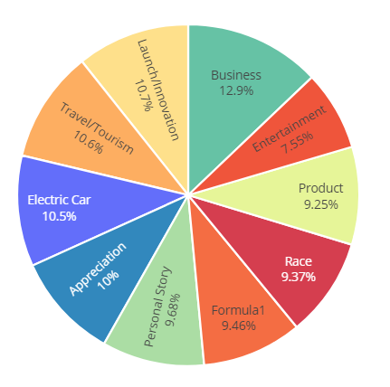
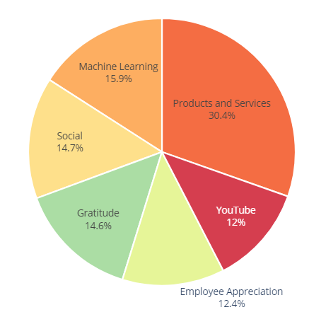
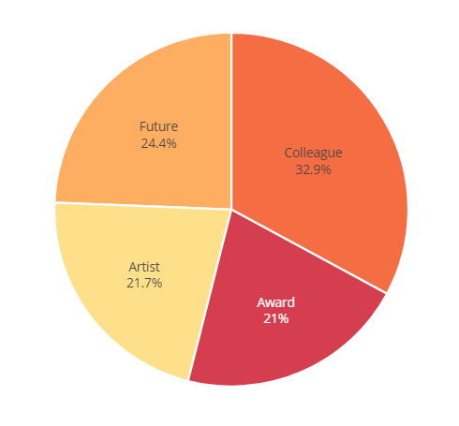
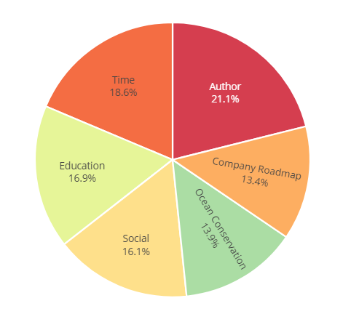
Other CEO Tweets Topic Modeling
Anand Mahindra
Sundar Pichai
Daniel Ek
Marc Benioff

